Slide 1
Introducing Points.com for Magento
Increase sales
and drive growth with a unique new incentive program

Slide 2
The Booming Business of Loyalty

Slide 3

In the increasingly competitive e-commerce industry, incentive programs are an integral way to help grow your business.

Slide 4
By rewarding loyalty points/miles, you can:
Extend your reach
Right now there are over 2 billion loyalty program memberships in the US and 120 million in Canada
The average US household participates in 18 loyalty memberships

Slide 5
By rewarding loyalty points/miles, you can:
Attract and retain high-value customers
More than 90% of frequent flyers said they would switch to a merchant that offers reward miles
84% of people feel that an online store that offers points/miles would make them more likely to return
78% said that being offered points/miles would make them more likely to complete their purchase
Offering loyalty rewards can increase repeat shopper annual visits by 15-20%
Loyalty program members spend 13% more than non-members
Customers are about 6 times more likely to convert on offers that include airline miles
Sources:
Colloquy Loyalty Census, 2011
Forrester North American Technographics® Retail Online Survey, Q3 2009 (US)
Cartera eCommerce
Points.com – Point of View Panel, June 2011
Billeo, March 2012

Slide 6
Introducing Points.com for Magento

Slide 7
Increase conversion. Drive more sales.
Grow your business.
For the first time ever, online merchants can offer their customers points/miles from the biggest loyalty programs in the world. It is now possible to reward customers with the points/miles that they already collect and value which has proven to drive increased basket size and purchase frequency.
Points.com is an innovative and completely unique solution that can be set up easily and tailored to every online merchant’s business.

Slide 8

Increase conversion. Drive more sales.
Grow your business.
v
Your customers can choose points/miles from some of the world’s biggest loyalty programs with over 200 million active users combined.

Slide 9
The Many Benefits of Points.com for Magento

Slide 10
In addition to the ease of set up, with Points.com for Magento, you can:
Increase sales by 20% or more
Generate return visits by offering rewards in the programs your customers want, from some of the biggest loyalty programs in the world
Exercise complete control and flexibility over how the program operates
Boost your brand through association with world-renowned loyalty brands
Gain market exposure through Points.com’s 3.1 million members
Enjoy the simplicity of no extra accounting or financial tracking requirements for the points/miles distributed to your customers
Use technology that is powering over 1,250 merchants’ loyalty programs

Slide 11
How Points.com for Magento works

Slide 12
Exceptionally easy to set up, Points.com for Magento is a robust incentive program unlike any other available.
Download and install the Points.com for Magento extension
Purchase generic points and miles that can be distributed by any denomination through award codes

Slide 13
Exceptionally easy to set up, Points.com for Magento is a robust incentive program unlike any other available.
Choose the actions you want to reward your customers for. These can include:
Customer spend
Promotional purchases
Referring other customers
Customer birthdays
Rating and reviewing products
Signing up for emails
Registering for the site
Customers then receive an award code and can decide which loyalty program they would like to deposit their points/miles into

Slide 14
Points.com for Magento in Action

Slide 15
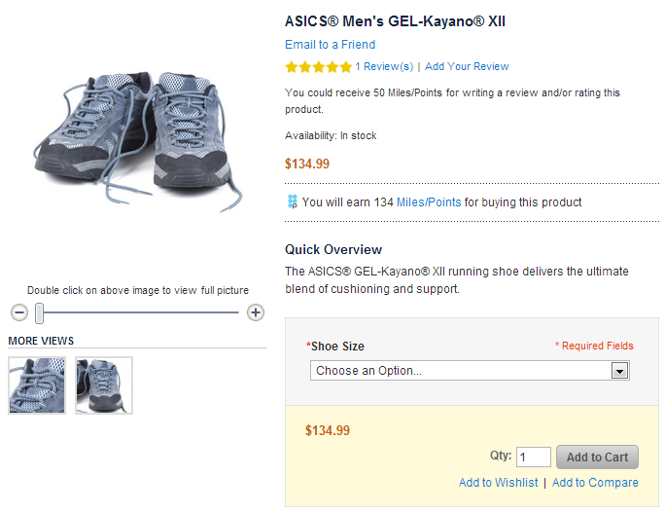
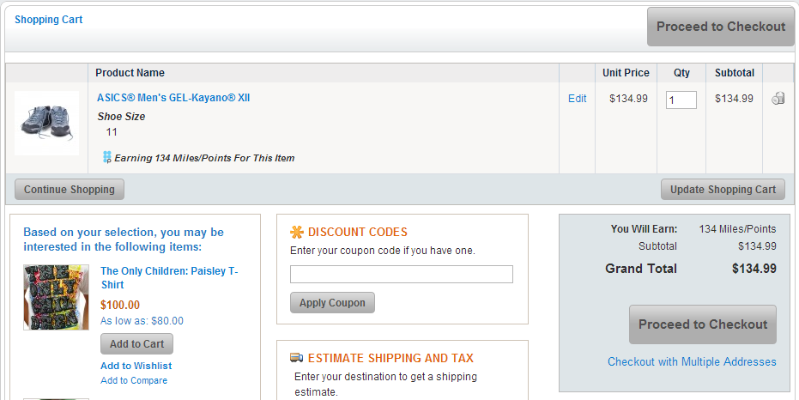
Points.com integrates directly into your existing merchandizing and checkout flow
Checkout Page
Product Page

Slide 16
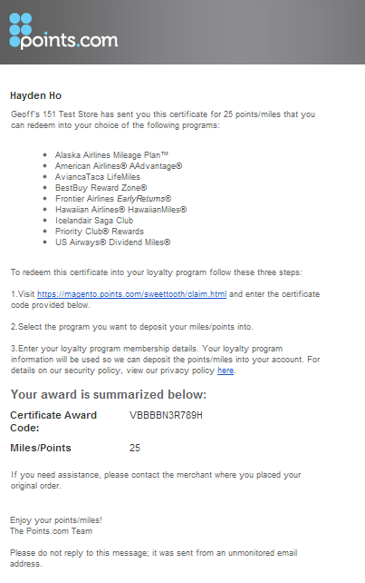
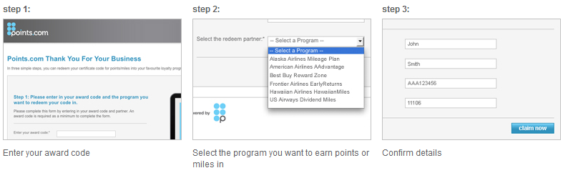
Redemption is simple and automated – an auto e-mail is sent to the purchaser and they choose their favorite loyalty program

Slide 17
Marketing Opportunities for Merchants

Slide 18
We’re dedicated to working with merchants to promote their online stores and help their customers earn points/miles.
As part of the Points.com for Magento program, you’ll get:
Placement on the Points.com Earn Opportunities feed on the Points.com homepage
Positioned on the Points.com Earn page
Access to email support to the Points.com user base
Ad placement on Points.com
Partner support in placements and emails
Banner support for your site with official loyalty program logos

Slide 19
What you should know about Points.com

Slide 20
A market leader in loyalty, you can be sure that by partnering with Points.com, your business will benefit.
Launched in 2000
Listed on the NASDAQ (PCOM) and the TSX (PTS).
Global leader in reward currency management, providing multiple eCommerce and technology solutions to the world's leading loyalty brands.
Enhances loyalty program consumer offerings and back-end operations for more than fifty partners worldwide.
Deliver more than $300 million in additional revenue for our partners each year.
Our experience means our partners benefit from a larger perspective on loyalty.

Slide 21
Thank You!
For more information or to set up Points.com for Magento,
please contact me:
John Smith
416.555.5555
John.Smith@gmail.com

